Slide 1
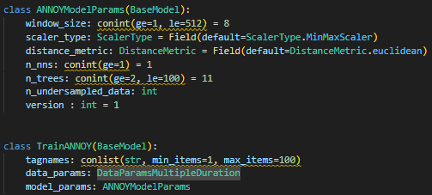
FLOW – 기존 학습시 과정
Api_server/models/annoy.py
ModelManager
Tag, 기간, 파라미터 지정 후 strat training
Api_server/apis/routes/annoy.py
Model/prediction/annoy.py
Request = TrainANNOY
Model = ANNOY(modelname = modelname)
Process(model_training)
ANNOY(PredictionBaseModel)
Define_model()
Model/prediction/base_model.py
Api_server/apis/multiproc/annoy.py
Create_model_dir()
Path지정
Model_path = config(“C:/ProgramData/GaonPlatform/Model_data”)
Base_path = Model_path + model_key(model_name)
Save_json_path = base_path + model_key_info.json
Save_scaler_path = base_path + model_key_scaler.pkl
Save_model_path = base_path + model_key_확장자명
Model_training
save_json(save_model_info)
define_model()
모델 학습
get_scaler()
save_model, save_scaler()

Slide 2
FLOW – Version추가 후 학습시 과정
Api_server/models/annoy.py
ModelManager
Tag, 기간, 파라미터 지정 후 strat training
Version : int =1 추가
파라미터에 Version정보 추가
Api_server/apis/routes/annoy.py
Model/prediction/annoy.py
Request = TrainANNOY
Model = ANNOY(modelname = modelname)
Process(model_training)
ANNOY(PredictionBaseModel)
Define_model()
Define_model() self.model_version = model_version 추가
version = request.model_params.version
ANNOY(modelname, version)
Model/prediction/base_model.py
Api_server/apis/multiproc/annoy.py
Create_model_dir(base_path)
Path지정
Model_path = config(“C:/ProgramData/GaonPlatform/Model_data”)
Base_path = Model_path + model_key(model_name)
Save_json_path = base_path + model_key_info.json
Save_scaler_path = base_path + model_key_scaler.pkl
Save_model_path = base_path + model_key_확장자명
Model_training
save_json(save_model_info)
define_model()
모델 학습
get_scaler()
save_model, save_scaler()
Base_path =
Model_path + model_key + version

